Slide 1
Credit Loan Approval
Kavish, Chang and Damian

Slide 2
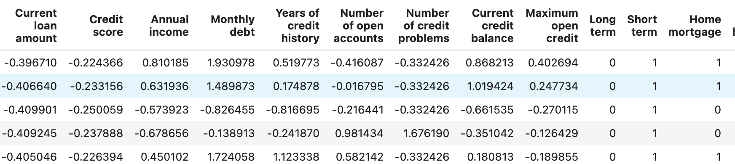
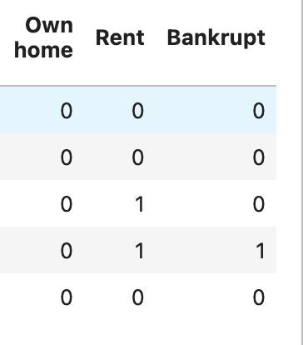
Background
Dataset: https://www.kaggle.com/datasets/zaurbegiev/my-dataset
Variables in the dataset: Loan ID, Customer ID, Current loan amount, Term, Credit Score, Annual income, Current years in job, Home Ownership, Purpose, Monthly dept

Slide 3
Data Cleaning
Unwanted values were dropped based on research, this included null values within the dataset.
The following data was dropped during the data cleaning process: Loan ID, Customer ID, Years in current job, Loan status, Tax liens and purpose.
Dataset was standardized in order to preform machine learning

Slide 4
Models
Random Forest
Neural Networks
Essemble

Slide 5
Random Forest
Random Forest is an ensemble learning method commonly used for classification, regression, and other machine learning tasks. It belongs to the family of tree-based models and is known for its high accuracy, robustness, and versatility.
Optimization: The model was optimized by altering the number of trees, tree depth and feature importance.

Slide 6
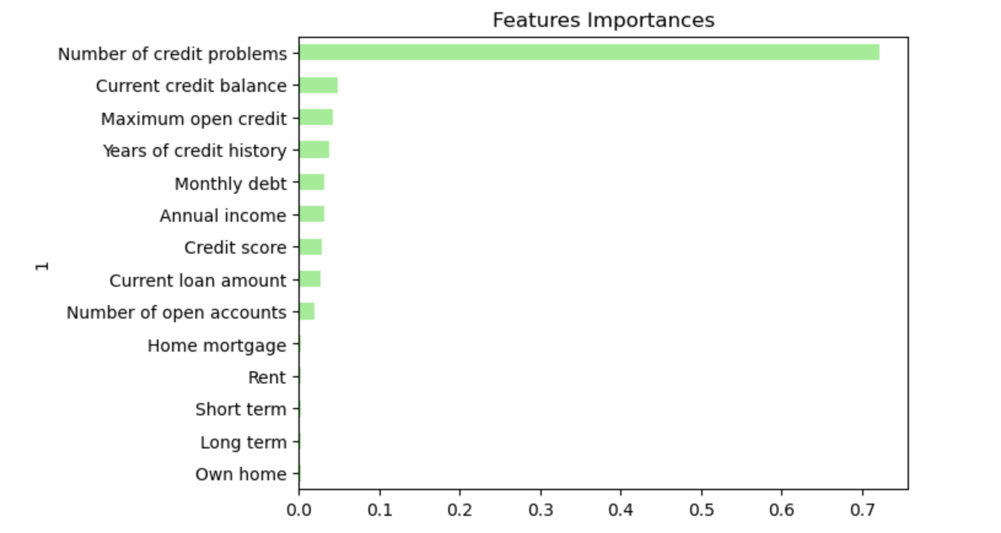
Random Forest

Slide 7
Neural Networks

Slide 8
Essemble

Slide 9
User interface

